Slide 1
Week 7b – 2-D Arrays

Slide 2
2-Dimensional Array
A 2-D array works the same as a 1-D array except we have 2 separate subscripts.
Declare a 2-D array using two sets of brackets:
Ex. int numbers[2][3];

Slide 3
2-Dimensional Array
Ex. int numbers[2][3];
Think of 2-D arrays as being a table with rows and columns.
The example above would have 2 rows and 3 columns.

Slide 4
2-Dimensional Array
Ex. int numbers[2][3];
Very similar to a matrix that has 2 rows and 3 columns
In a matrix the first element would be 1,1 and the last would be 2,3
In an array, however, the first element would be 0,0 and the last would be 1,2

Slide 5
Initializing A 2-D Array
Similar to a 1-D array you still use { } except each row must be enclosed as well.
Ex.
int matrix[2][3] = {{0, 1, 2} , {3, 4, 5}};
Look at the following program that will let you print the contents of the array matrix

Slide 6
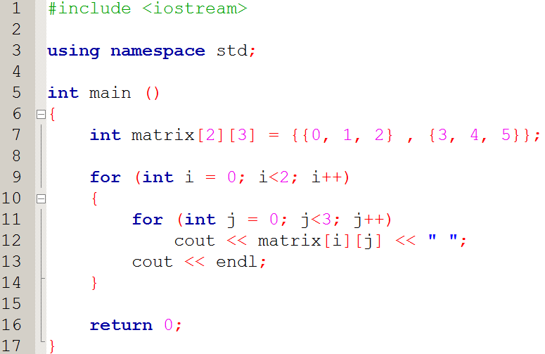

Slide 7
2-Dimensional Array
Notice that to print the elements in a 2-D array, you must use a nested loop.
Nested loops are also used to read values into a 2-D array.
VERY IMPORTANT: Remember that the i^{th} row and j^{th} column, are accessed by using the subscripts [i-1][j-1]

Slide 8
Sending Arrays to Functions

Slide 9
Prototypes for 1-D Arrays
The prototype must indicate an array variable
Example prototypes:
void printArray (int [ ]);
void printArray (int [3]);
There are multiple ways of sending the number of elements to an array.
Number of elements not sent
Number of elements is sent

Slide 10
Prototypes for 2-D Arrays
The prototype must indicate an array variable
Example prototypes:
void printArray (int [ ][3]);
void printArray (int [3][3]);
When sending a 2-D array, the number of columns MUST be specified. The number of rows is optional.
Number of rows not sent
Number of rows is sent

Slide 11
Function Calls For Arrays
To send an array to a function, you only include the name of the array. You do not include [ ]
Example
void printArray (int [3]); //Prototype
…
int numbers[3] = {4, 7, 9};
printArray (numbers);
Notice, there are no [ ]

Slide 12
Function Calls For Arrays
This is the same for double arrays
Example
void printArray (int [2][3]); //Prototype
…
int numbers[2][3] = {{4, 7, 9},{-1,2,-3}};
printArray (numbers);

Slide 13
Function Headers
The function header must include the same information as the prototype
The name of the array can be a different name than that which called it
REMEMBER: Arrays are ALWAYS treated as reference variables so if you change the contents inside a function, it changes it in main also.

Slide 14
Function Headers
//Prototype
void printMatrix (int [3][3]);
//Call
printMatrix (matrix1);
//Header
void printMatrix (int matrixArray[3][3])
Even though matrix1 and matrixArray have different names, they are reference variables so what happens to matrixArray changes matrix1.

Slide 15
Look At Example Programs

Slide 16
Program 1
Create a program that reads the answers from a 10 question multiple choice exam. The answers can only be: ‘A’, ‘B’, ‘C’, or ‘D’.
After the choices have been read, print the results to each question.
Example output:
Question 1 – You answered A
Question 2 – You answered C

Slide 17
Program 2
Modify program 1, so that it compares the answers the user entered to the correct answers:
1 – A 2 – B 3 – B 4 – D 5 – C
6 – A 7 – A 8 – D 9 – C 10 – C
Example output:
Question 1 – You answered A. The correct answer is A. Good job.
Question 2 – You answered C. The correct answer is B. Better luck next time.
…
Your grade on this exam is 30%.

